Slide 1


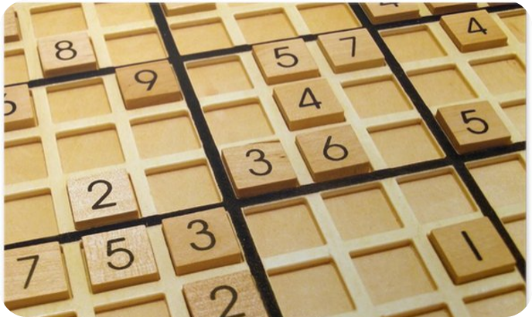
KBC
SUDOKU
Submitted to : Dr Shefali Arora
Submitted by : Alisha, Lavisha, PreetKamal
Roll No’s : 09,80,115

Slide 2
About Both Projects
Sudoku is one of the most popular classic games. This C Project provides a platform for users interested in this game to play it and improve themselves with its three levels : Easy, Medium, Hard. A 4*4 and 9*9 grid square helps one to improvise and exercise the brain, it also lets you know at the end the amount of time you took which you can improve in successive matches as it allows you to play as much as you want!.
KBC as we all see on television is an initiative by us to create a user friendly platform with the help of which you can get the actual feel of playing with Shri Amitabh Bachchan Sir. It can be used as a medium to practice questions and enhance your knowledge with the tricky Questions it contains. It contains all the 4 LifeLines too such as Flip the Question, Expert Advice, Audience Poll, 50-50 with the help of which you can have a hint or help and overcome barriers.

Slide 3
Acknowledgement
We would like to express our gratitude to Dr. Shefali Arora, our Computer Programming teacher because of whom we could successfully make our project, with the topics taught very well in the class which would clear our concepts and hence which resulted in the making of this project. Through this project, we learned a lot many things, that how things actually work practically, how a project is formed, we could widen our horizon through it and learn new things with their application as well. Overall making these projects was a great journey and we are thankful to the respective teacher and Computer Science department to have assigned us this project which could successively work out and enhance our knowledge.
Alisha, Lavisha and PreetKamal
Rno’s : 21103009,21103080,21103115

Slide 4
INDEX
SERIAL NO. | TOPICS COVERDED IN THE PROJECT
1 | Operators, Loops, If else and Switch case
2 | Arrays
3 | Functions
4 | Pointers And Structures
5 | File modes
6 | Header Files

Slide 5

LETS BEGIN

Slide 6
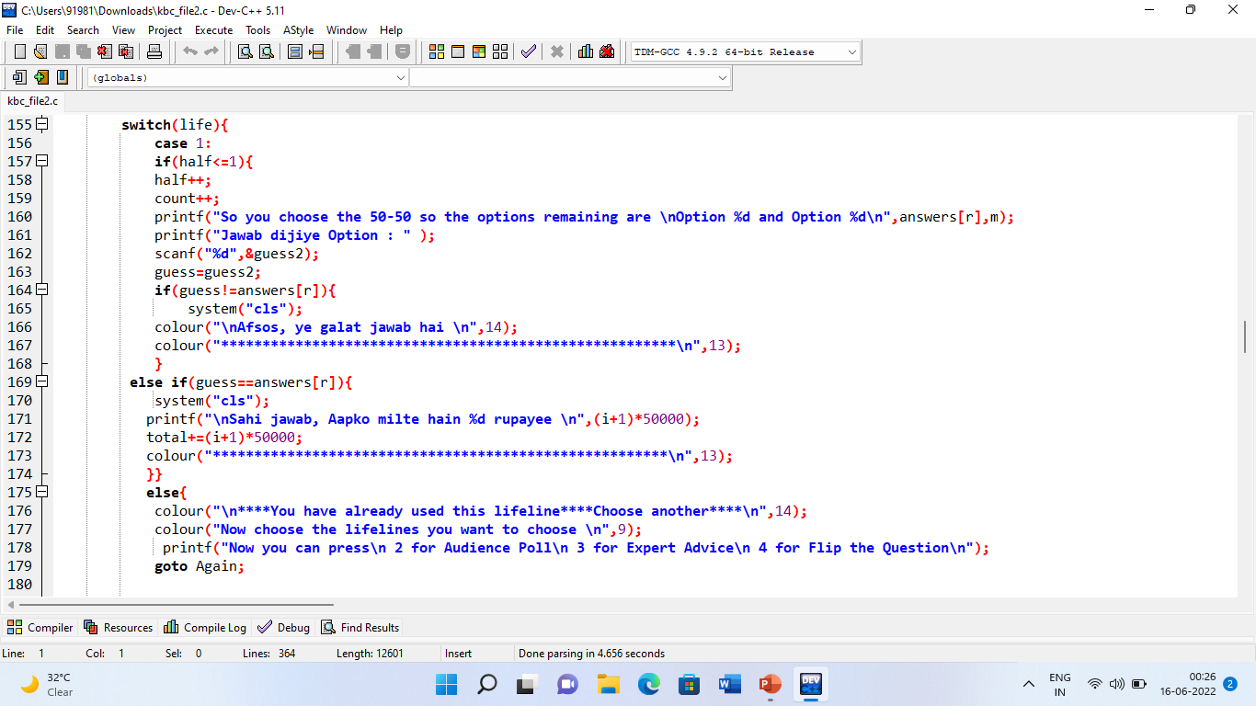
Operators, Loops, If-else & Switch
Operators used :Assignment, Logical, Arithmetic, Unary, Relational
If else used for setting conditions such as to in usage of LifeLines, for error indications, for displaying correct or incorrect answers, selecting random Questions etc.
For : in File Operations and inputting requisite questions to user.
Switch used for making 4 Lifelines by putting in 4 different cases.

Slide 7
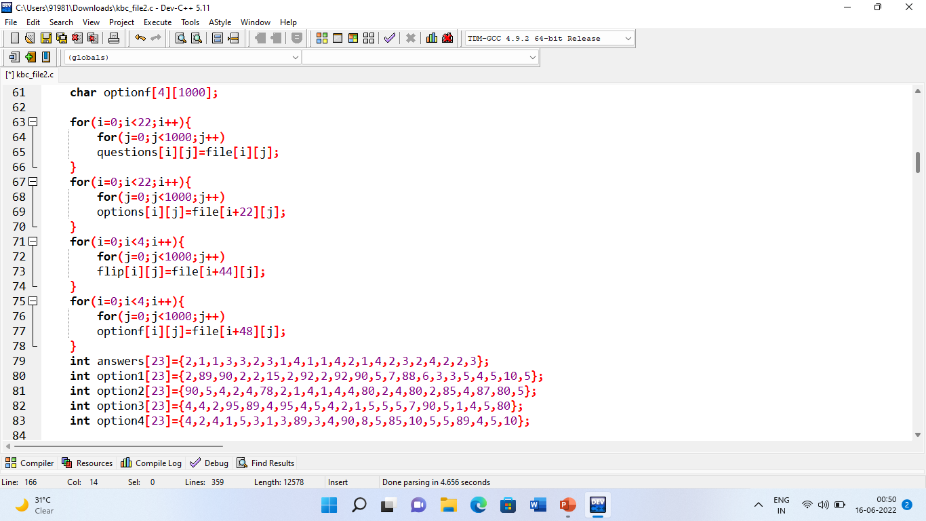
Arrays
Arrays store Questions of the Quiz and Answers along, some LifeLines such as Audience Poll work mainly on it.
It is further used in File handling Operations, creating File and used along If else conditions.
It stores the personal details such as name of user playing using Name array.

Slide 8
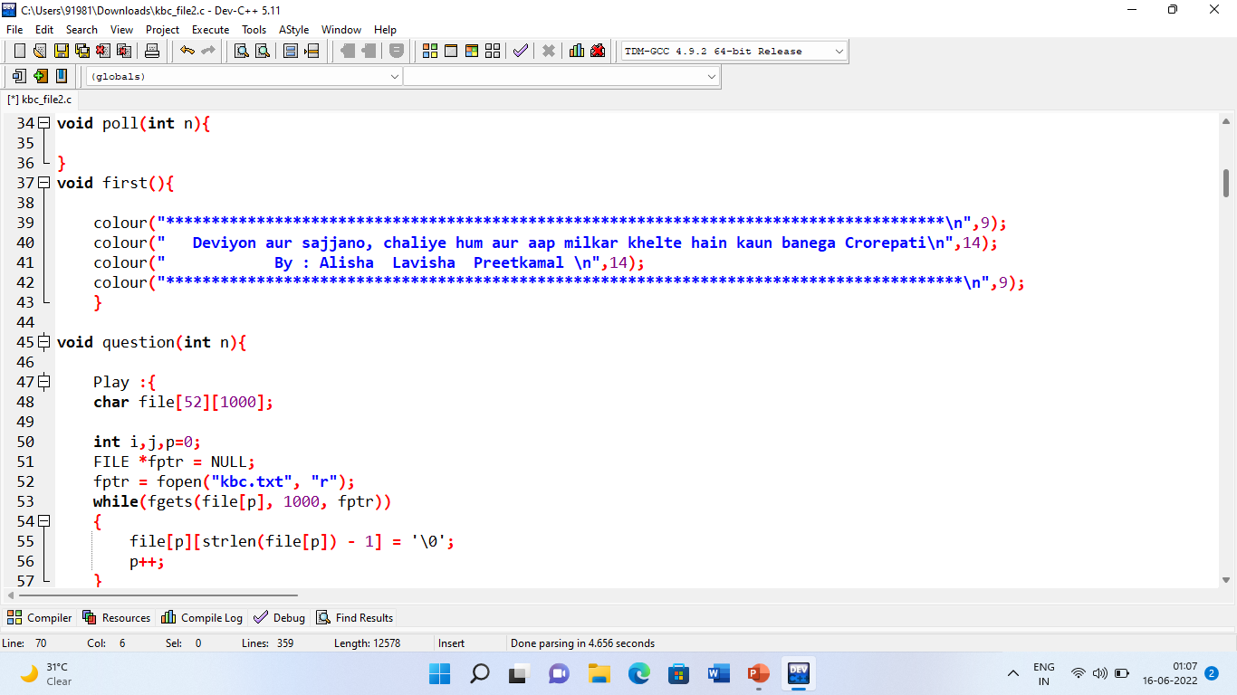
Functions
Just along in-built functions, some user defined functions are used such as for colour, questions, poll etc. using void.

Slide 9
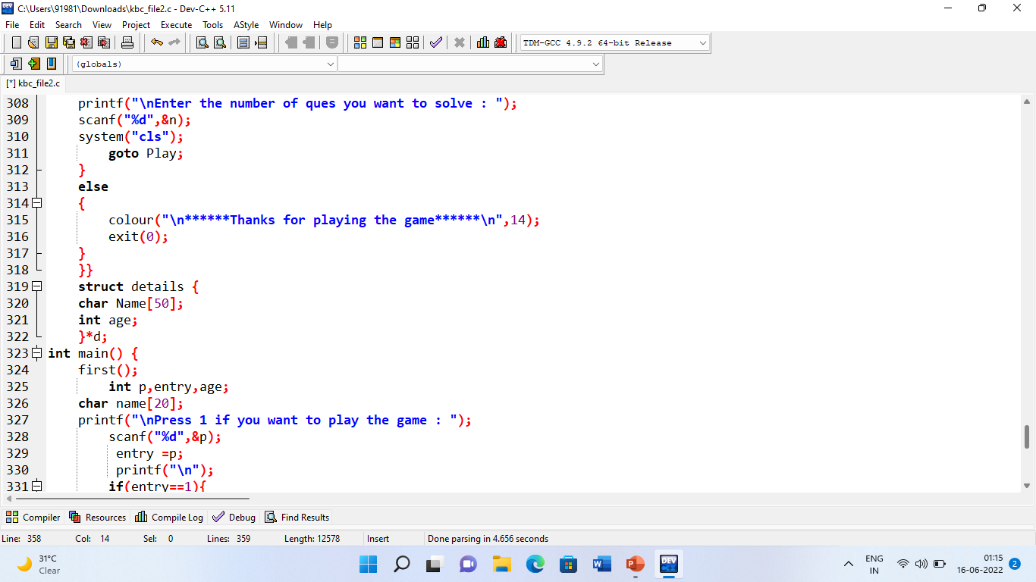
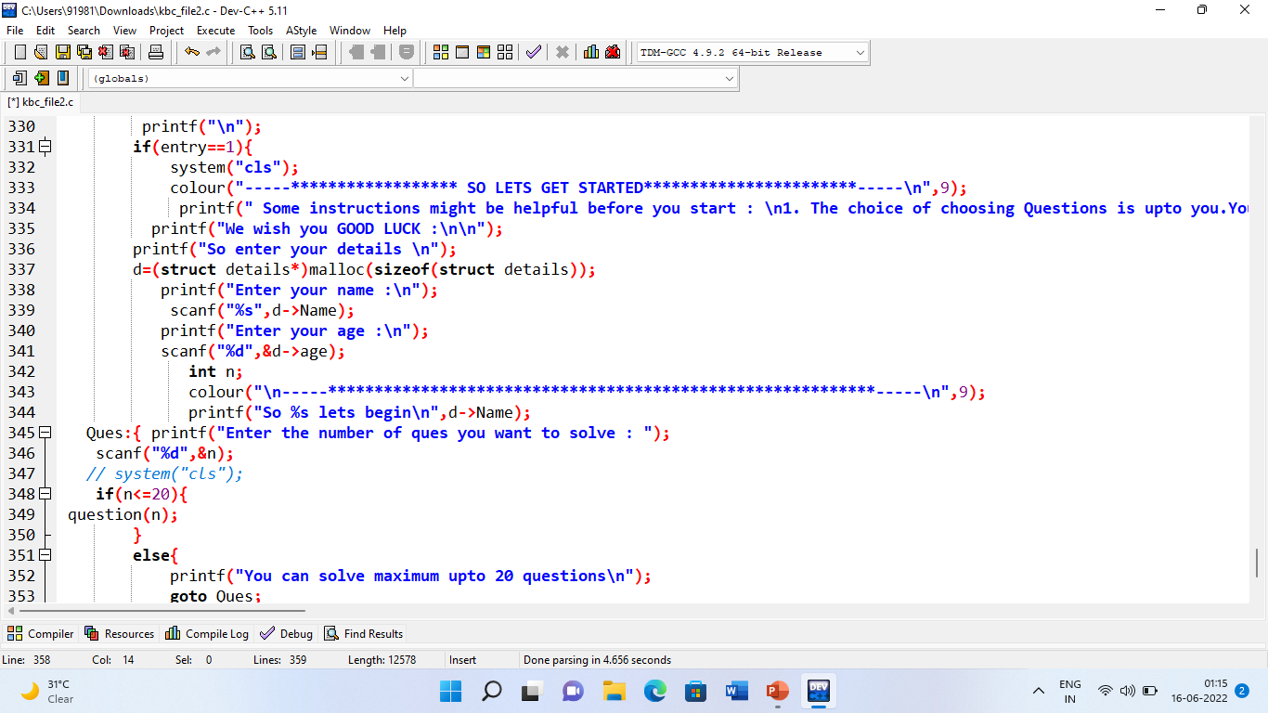
Pointers and Structures
Pointers and Structures are used together for storing personal details of the User such as Name and Age in the beginning, prior to playing
Further Pointers are used along File Handling Operations.

Slide 10
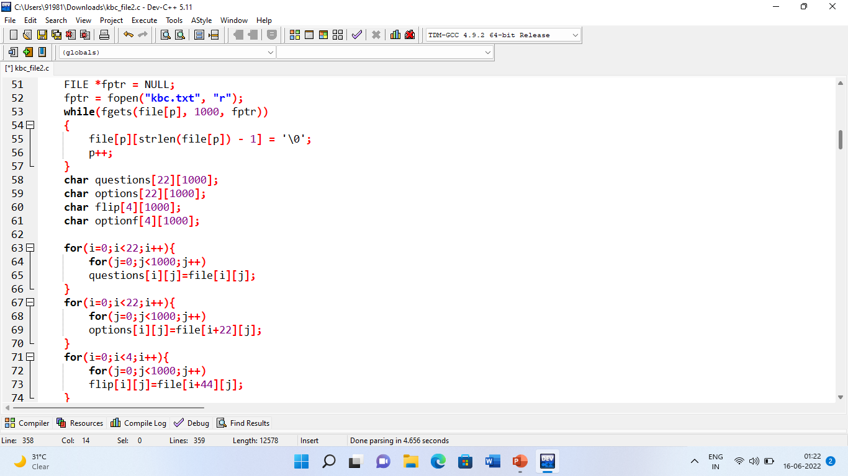

File modes
A kbc.txt File is created to store Questions and Answer options and FILE variable is used for displaying them with the code and working upon them further for LifeLines or for applying conditions on them using If, else and Switch.
Text File containing Questions attached here

Slide 11
Header Files
#include<stdio.h>
#include<stdlib.h>
exit() rand()
system() malloc()
#include<stdbool.h>
To store Boolean type data in an array.
#include<time.h>
time()
#include<string.h>
To perform the various operations on strings.
#include<MMSystem.h>
To add sound in the system
#include<windows.h>
To change the text color

Slide 12
Code of both Projects :

Slide 13
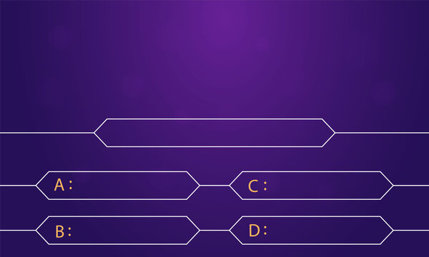
WORKING of KBC :
Which of these is made up of bones?
Walrus Tusks
Rhino Horns
Deer Antlers
Elephant Tusks

Slide 14
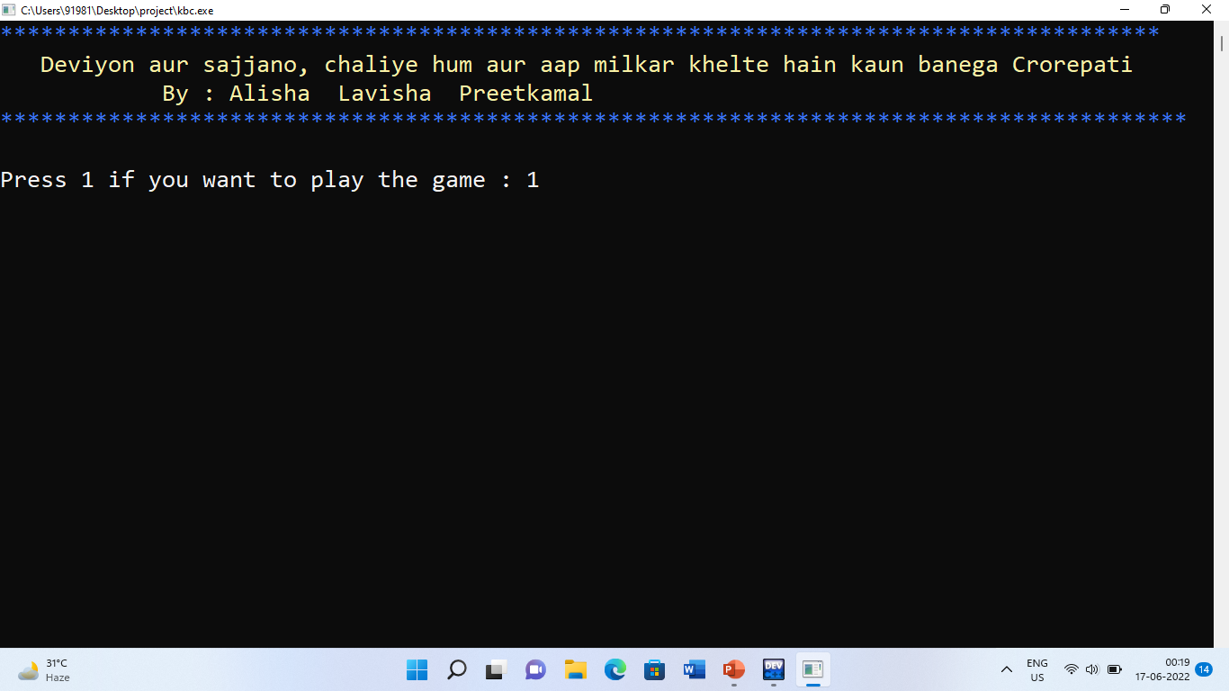
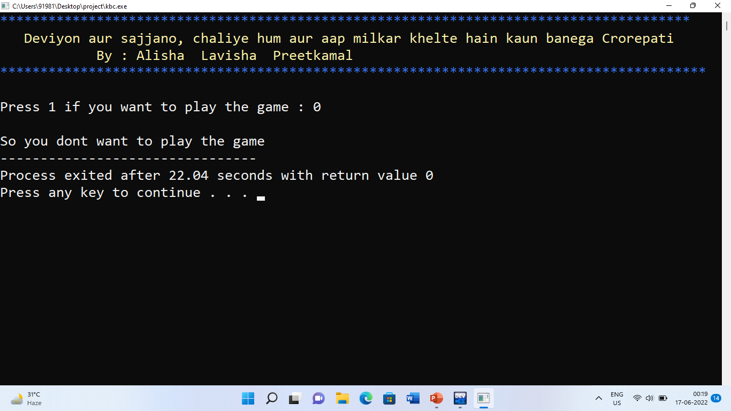
IF-ELSE CONDITION : By Pressing 1 only, you can play
Pressing any other key would mean you don’t want to play!.

Slide 15
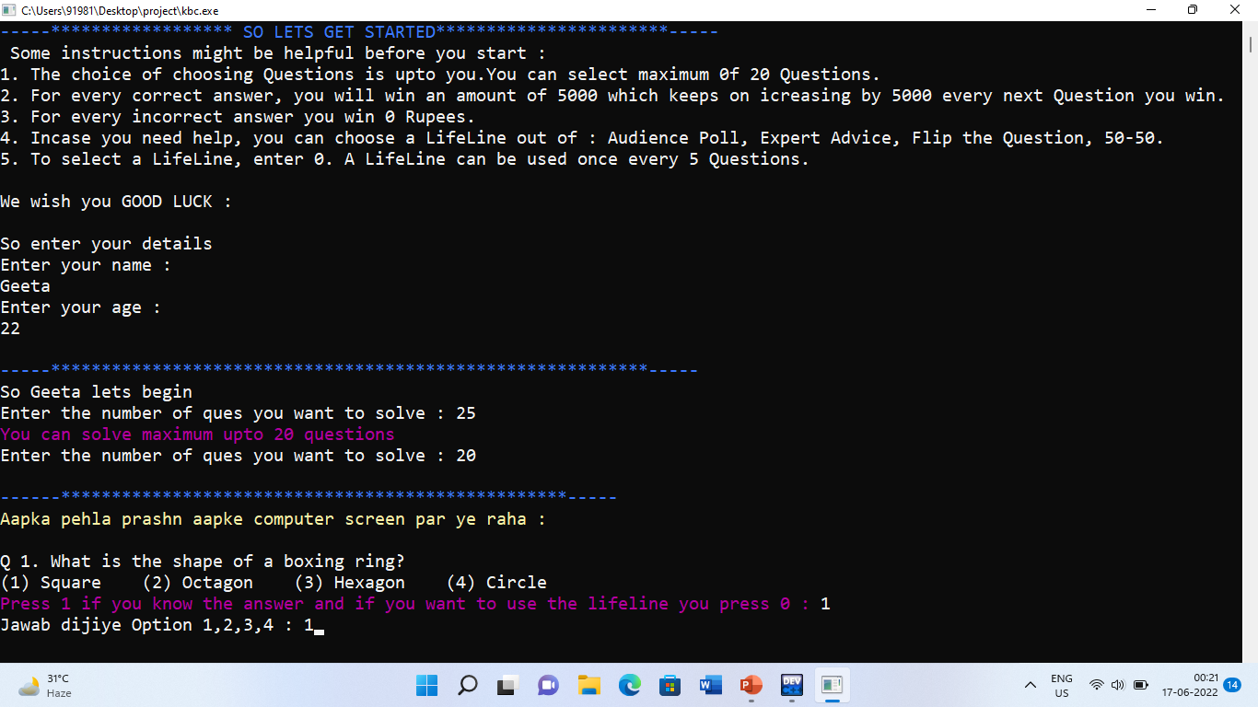
Next page appears which carries instructions, personal details created using Structures and Pointers, error message getting printed on not entering right no. of Questions and then 1st Random Question appears out of the kbc.txt file.

Slide 16
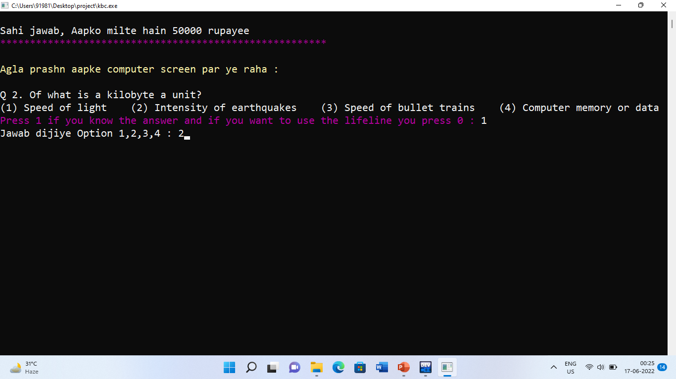
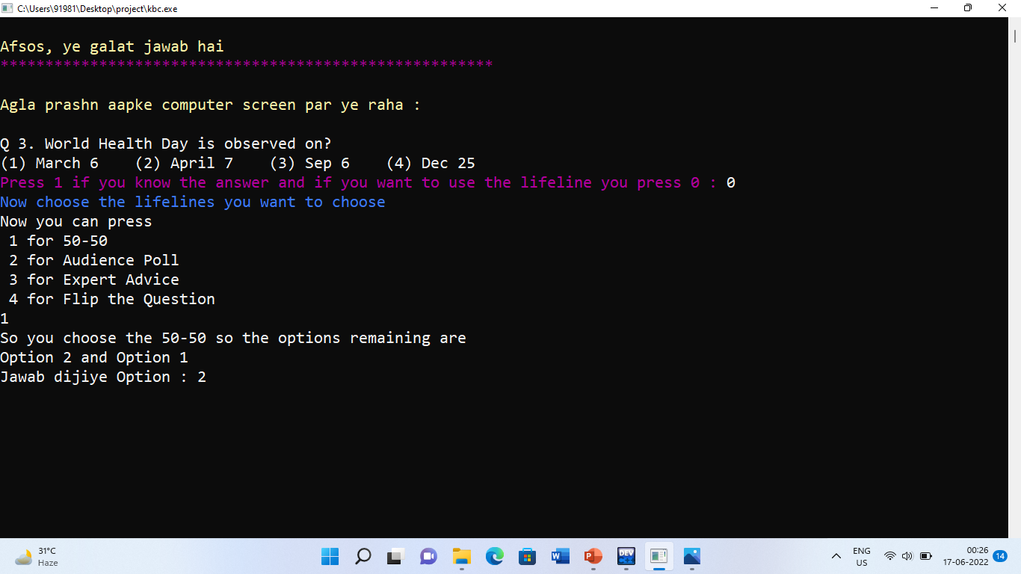
Entering every right answer awards you with 50,000 Rs and entering every incorrect answer awards you with 0 Rs
Like in this case Q1 was attempted right so user gets awarded whereas Q2 was attempted wrong so no amount received. This part was created using If-Else and Functions.

Slide 17
LifeLine No 1 : 50-50
Using the First LifeLine 50-50 which is created using Nested If, Switch case and Operators. It displays two correct options as an rest it leaves on User to decide the correct answer.

Slide 18
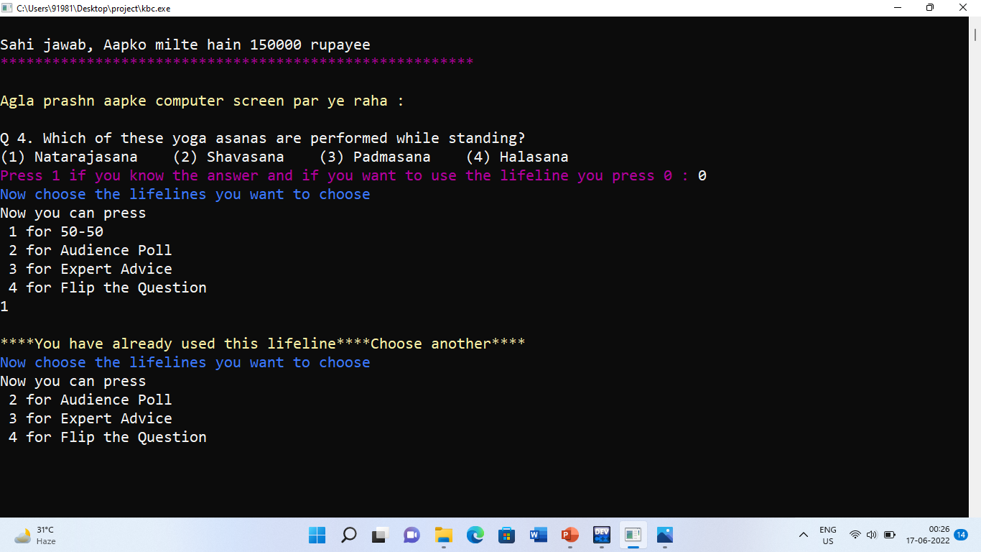
Any one LifeLine once used cannot be re-used as we will see further for 50-50’s case!. An error message will appear along with the options of other LifeLines available in case User is left with LifeLines. This part is also created by applying Conditions.

Slide 19
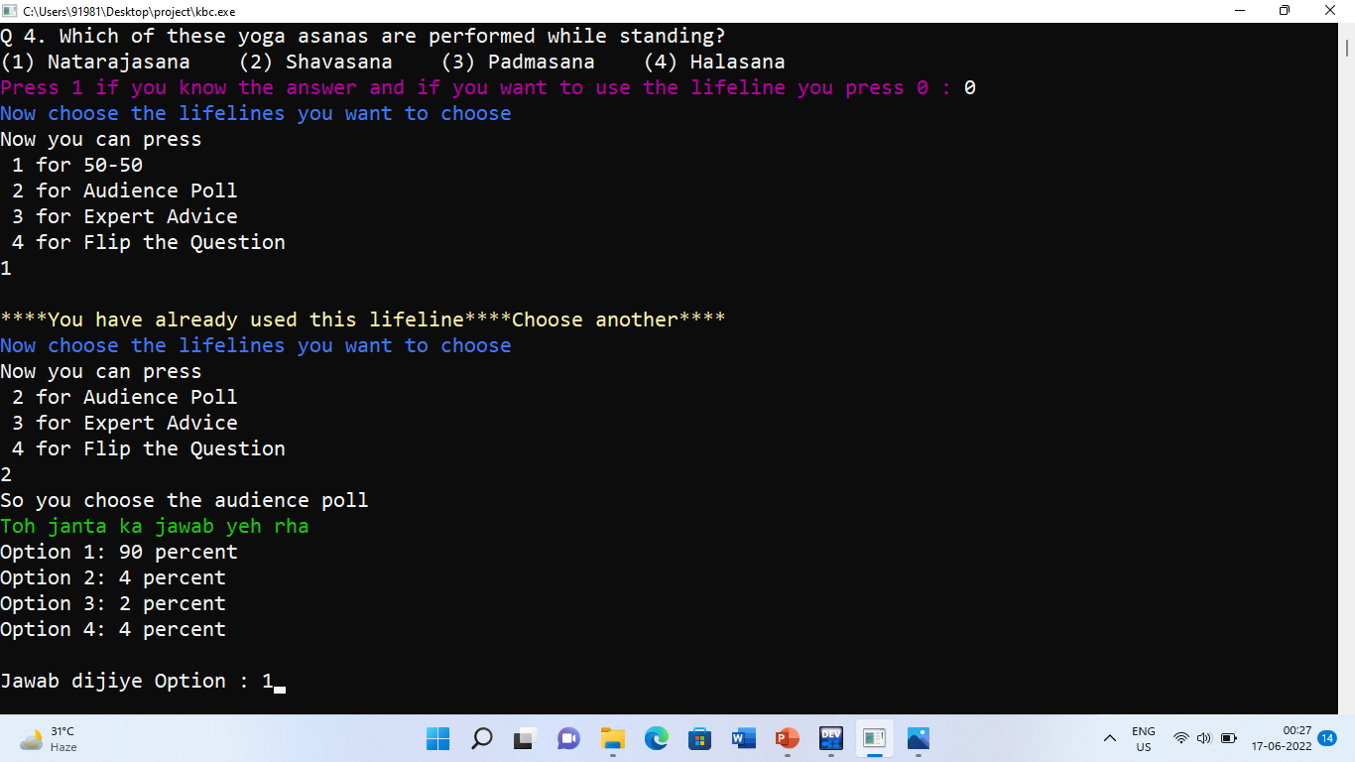
LifeLine No 2 : Audience Poll
The Audience Poll LifeLine gives you a percentage of highest and least voted answer by Audience. This part of the code is created using Arrays, Functions, Switch case and Nested If and Operators.

Slide 20
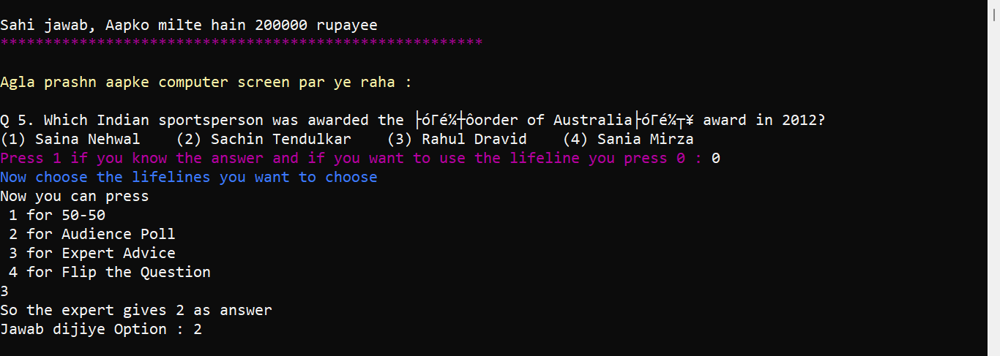
LifeLine No 3 : Expert Advice
The Expert Advice LifeLine gives you the correct answer directly as presented by Expert. This functionality of the code is created using Arrays, Functions, Switch case and Nested If and Operators.

Slide 21
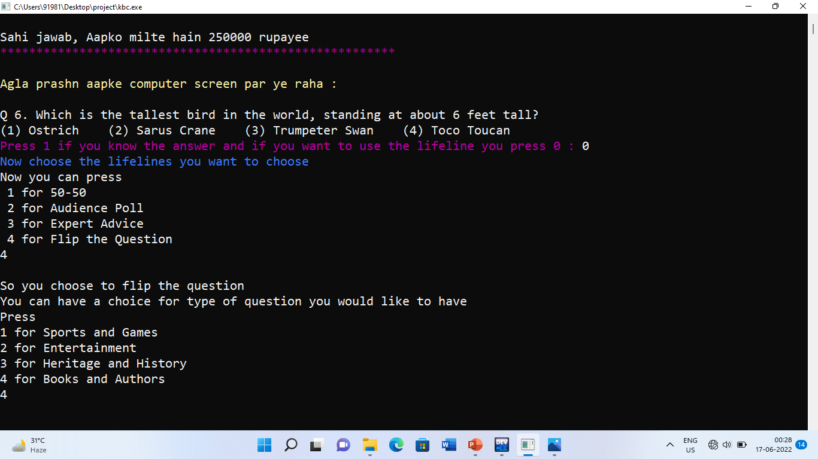
LifeLine No 4 : Flip the Question
The Flip the Question LifeLine takes you to a series of topics out of which user can select any one favourite topic and the Question for the same is replaced by that topic specific Question. This part of the code is created using Arrays, Functions, Switch case and Nested If and Operators.

Slide 22
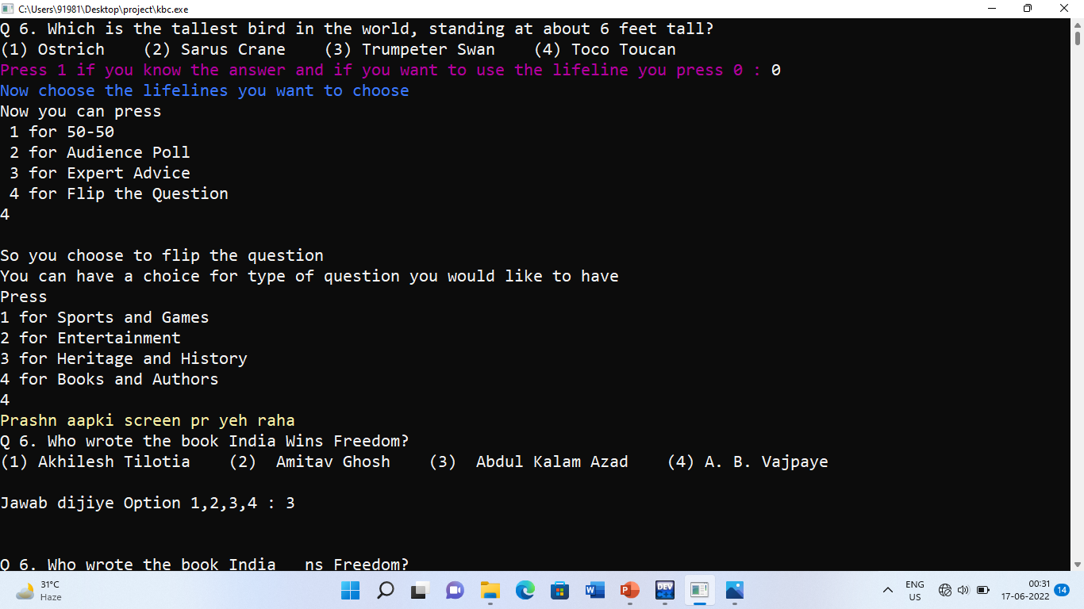
A new Question appears after flipping the previous Question.

Slide 23
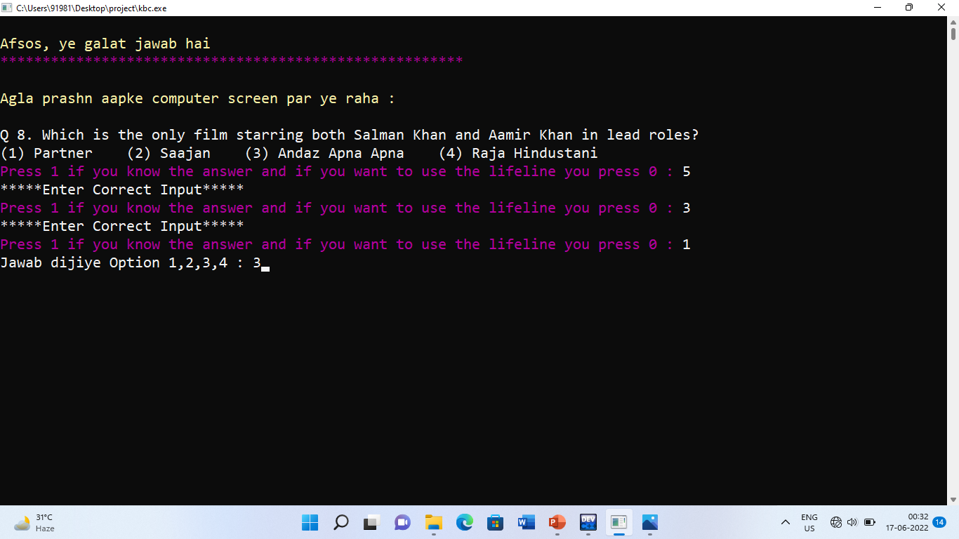
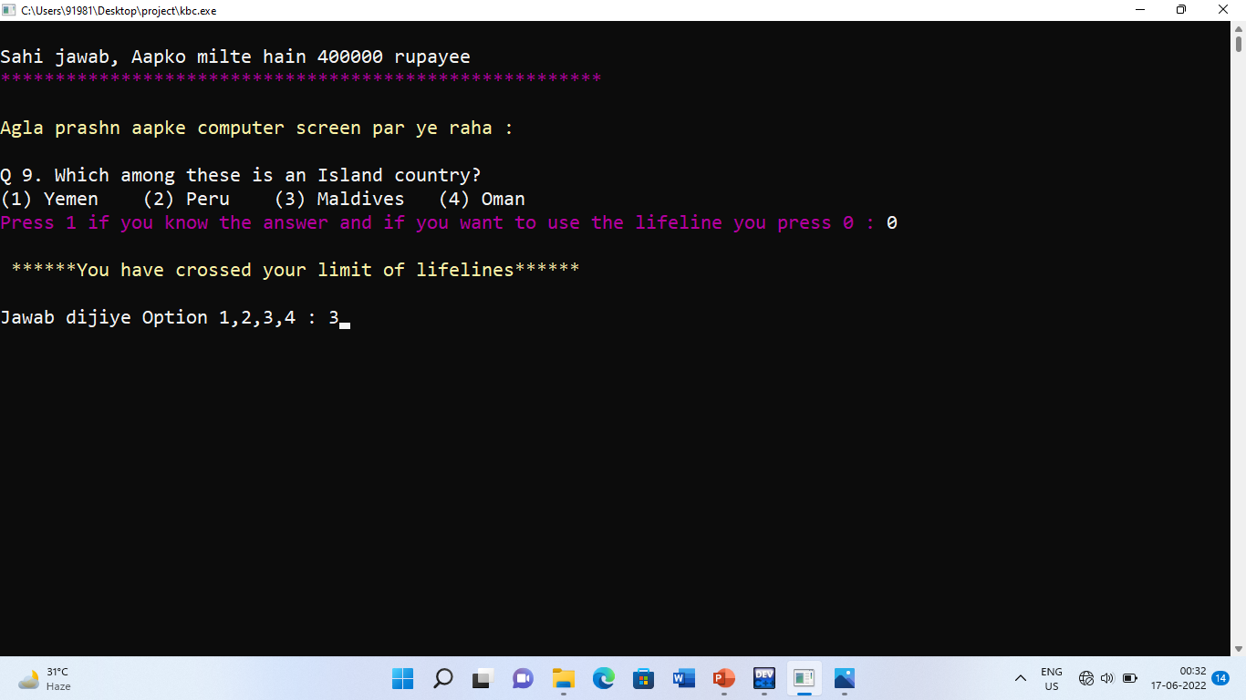
An error message gets displayed for entering wrong keyword. This part of the code is created using If,Else-If,Else condition, functions and labels.
An error Message gets displayed when the limit of LifeLines is over. For every 5 Questions, a LifeLine can be used only once, for 10 Questions twice, for 25 Questions thrice and for 20 Questions, four times. This part is created using Operators and If-Else

Slide 24
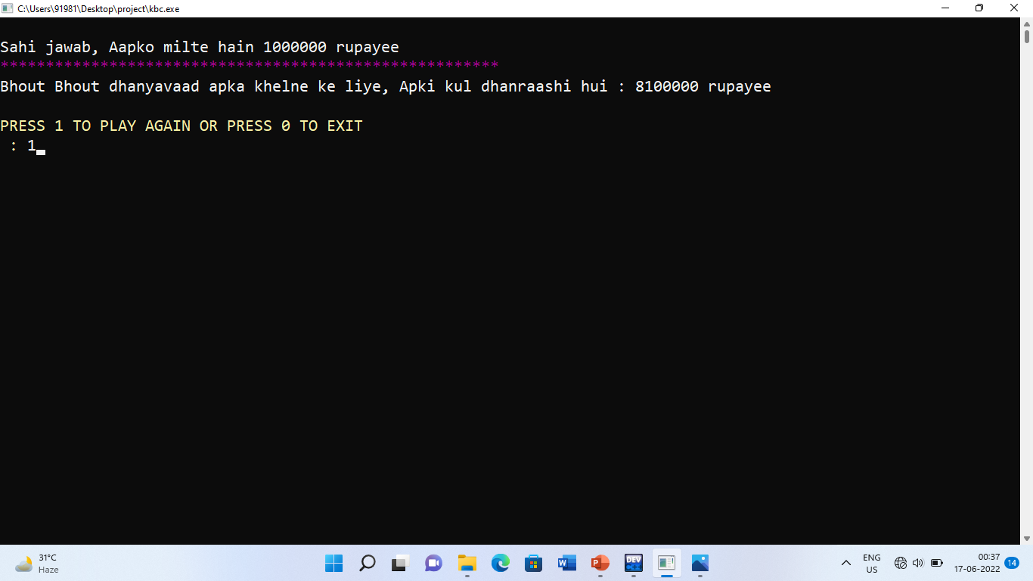
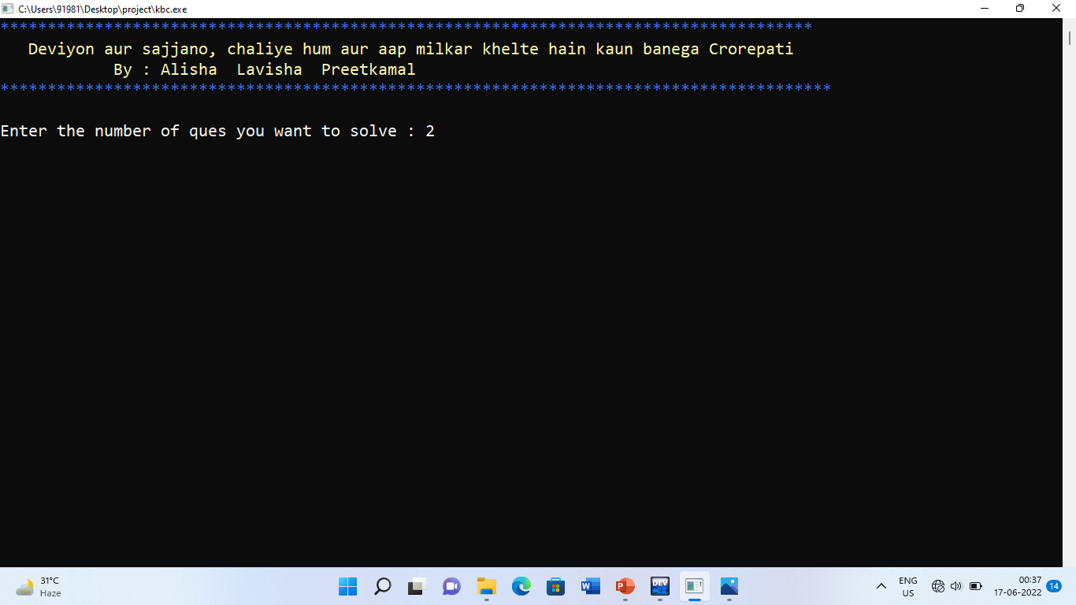
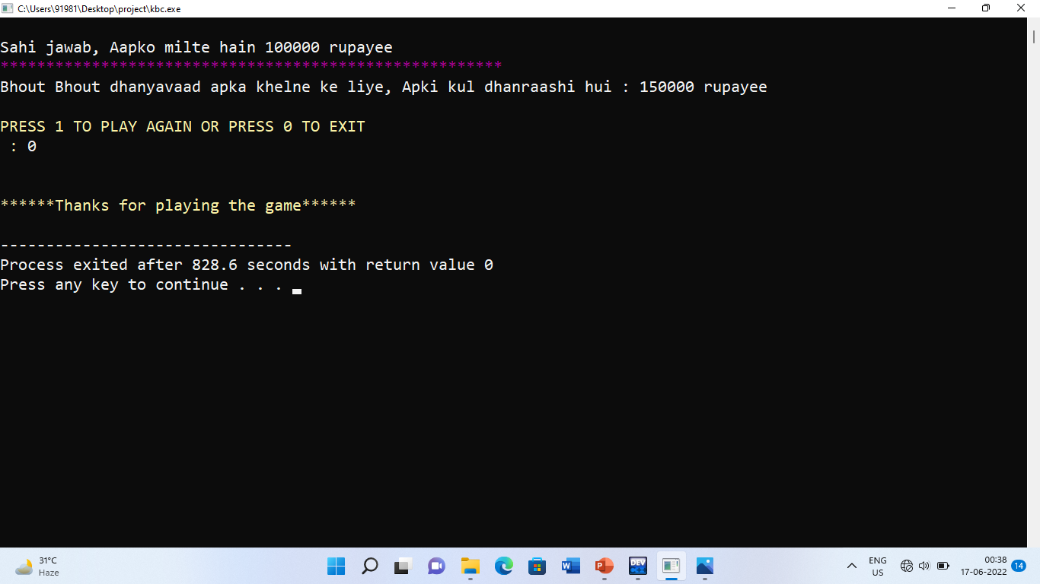
The Total Amount appears at the end with an option to Press 1 to play again which takes you to the Homepage again..!
And in order to exit, you can press 0 and the code terminates. This functionality of the code is created using Labels, Functions and If-Else

Slide 25
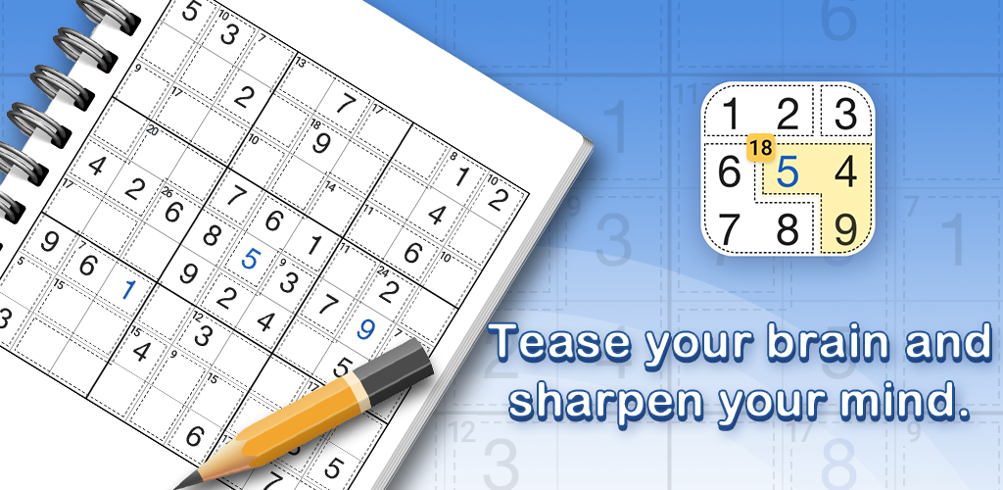

Slide 26
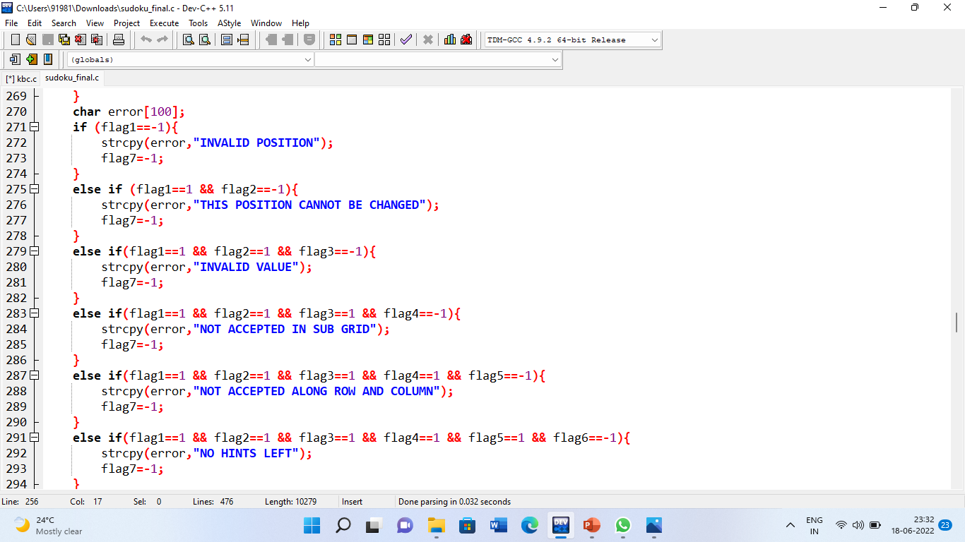
Operators, Loops, If-else conditions
Operators used : Assignment, Logical, Relational, Unary, Arithmetic Operators
Loops : While used for creating an infinite loop to input in grid, working of grid size and levels and For loop used for entering random values and along If-Else.
If-Else : used for setting different levels, setting colours, checking random values, determining position, values in sub-grid, along rows and cols, checking hints

Slide 27
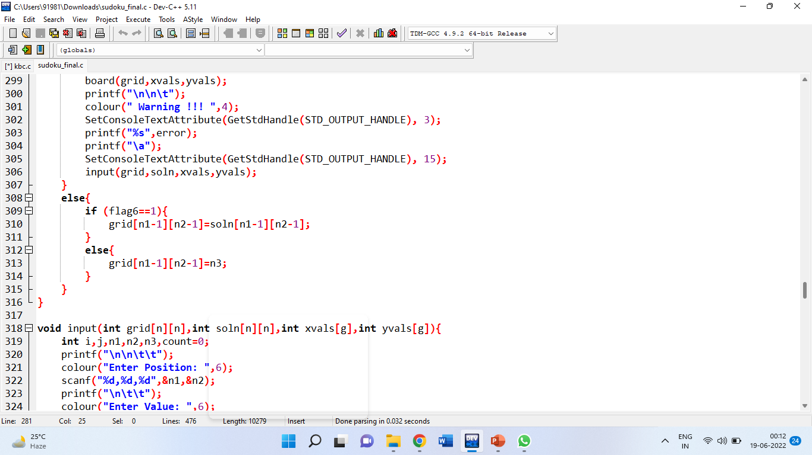
Arrays
Arrays are used to create a 4*4 and 9*9 grid entered by user, solution grid entered by computer, storing x and y coordinates, and to add colour in the output.
It is the backbone of the code and through this the random values get generated, User is able to play Sudoku till the end as it only presents grid, compares value entered by user with the final key etc using conditions and Loops.

Slide 28
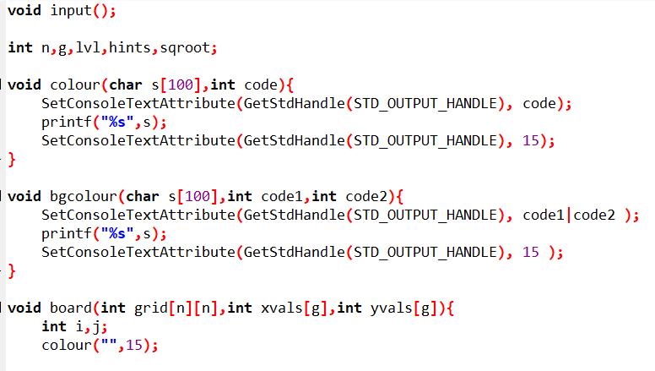
Functions
Various user-defined functions are used which manipulate the colour, bgcolour, the sudoku board which gets displayed to the User with unfilled values, information regarding the Easy, Medium and Hard levels, generating Random grid and for checking wrong Random values, for rectifying errors such as error in position or value entered by the User, Instructions not followed by the User and Errors related to Hints and the working of Hints.

Slide 29
Header Files
#include<stdio.h>
#include<stdlib.h>
exit() rand()
system()
#include<windows.h>
To change the text color
#include<MMSystem.h>
To add sound in the system
#include<time.h>
time()

Slide 30

WORKING OF SUDOKU

Slide 31
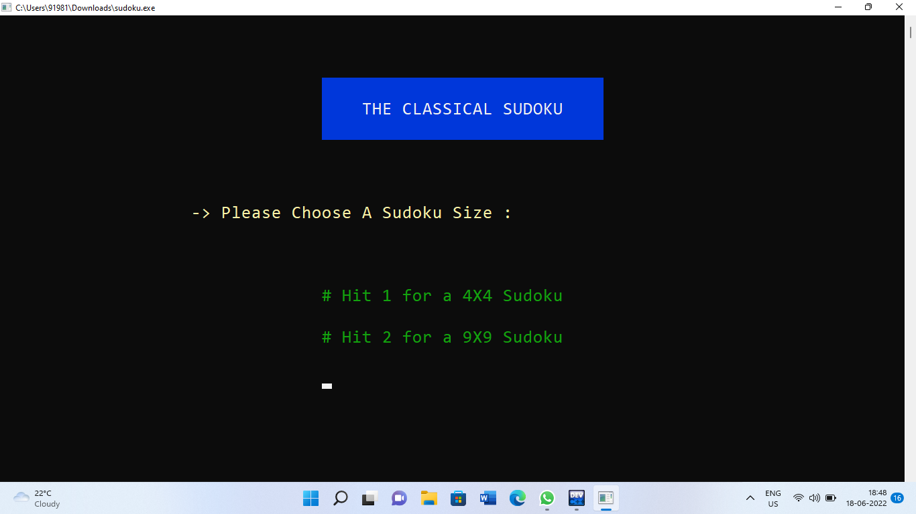
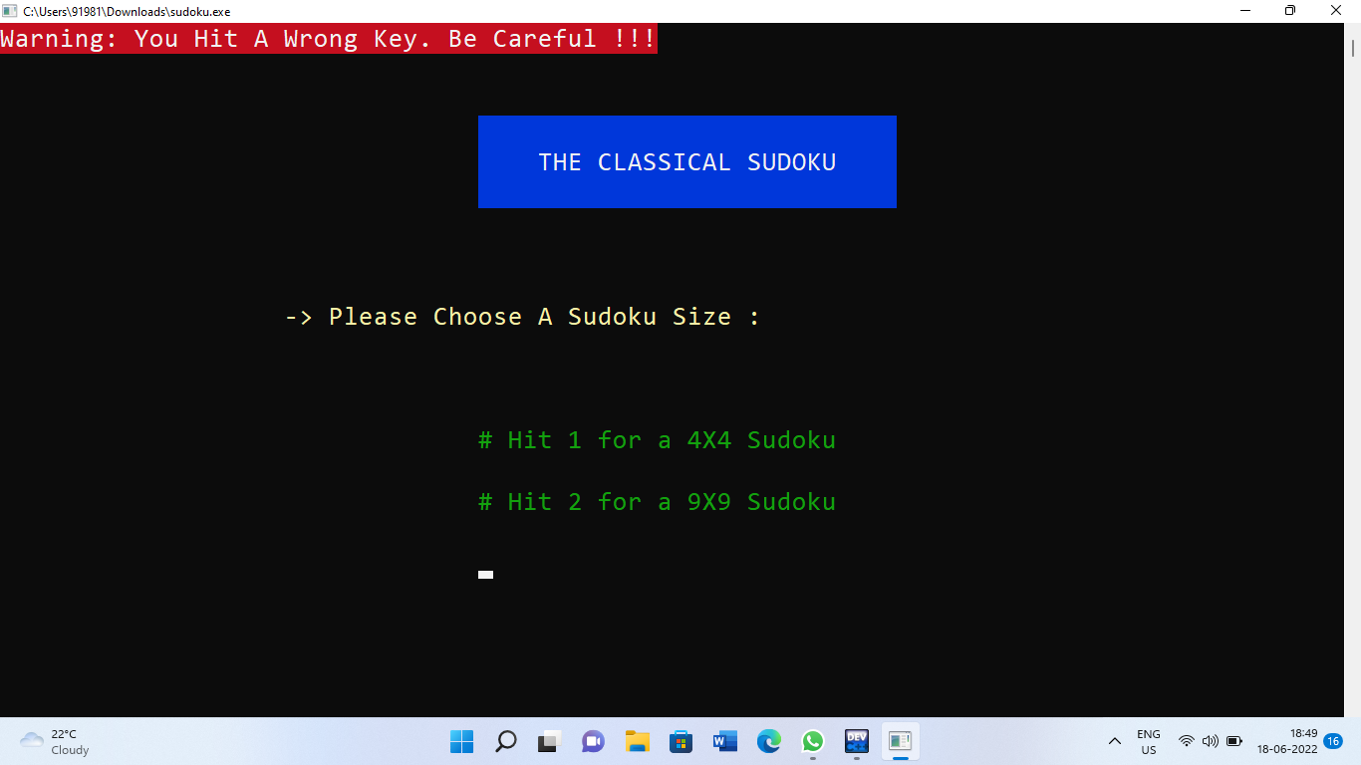
The Classical Sudoku consists of two grids : a 4*4 Grid and a 9*9 Grid. This Game gets started on only pressing the right keyword which is either 1 or 2. Pressing any other will lead to an error message as shown in right.

Slide 32
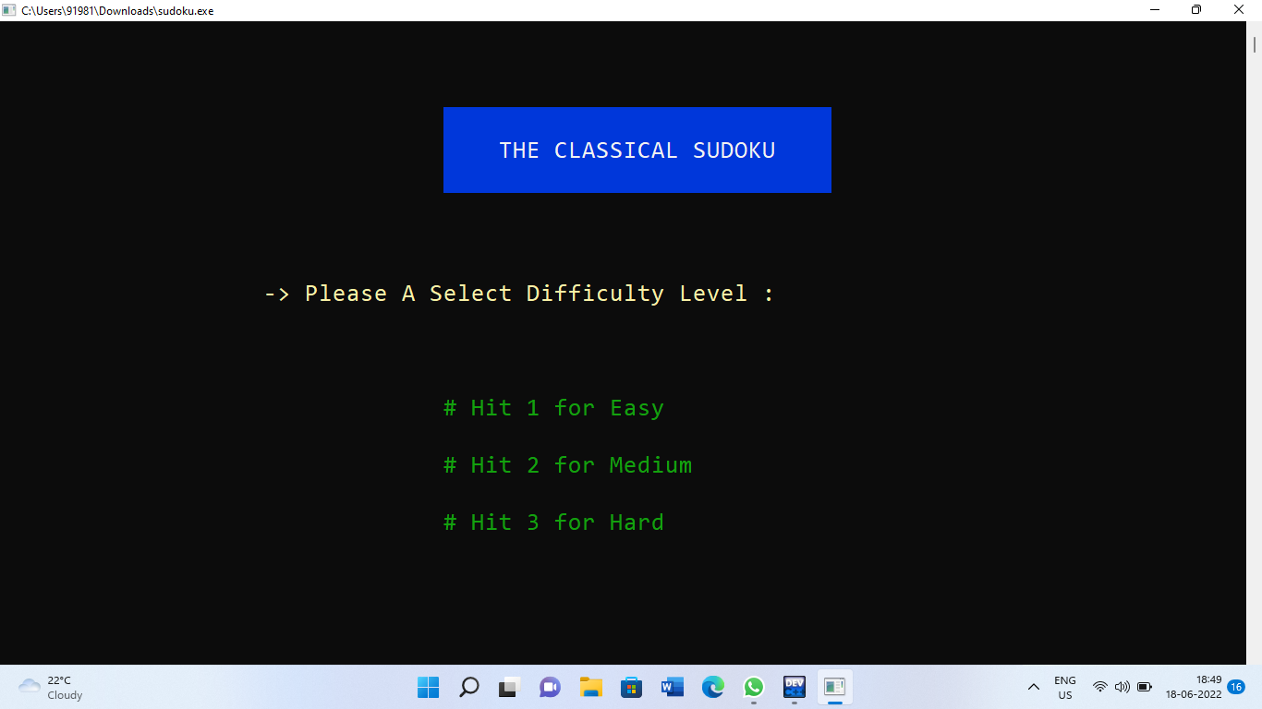
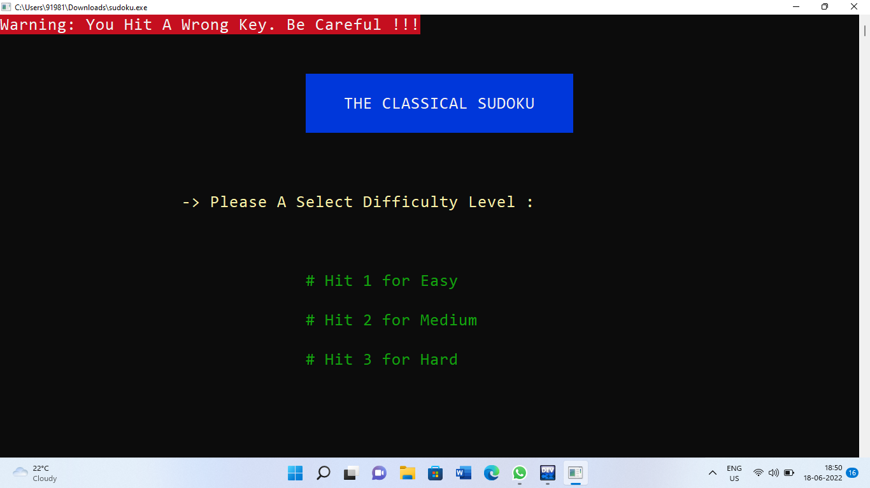
Next, choose the difficulty level. For a particular grid, there are 3 levels : Easy, Medium and Hard. An error message gets highlighted again as you press the wrong keyword.

Slide 33
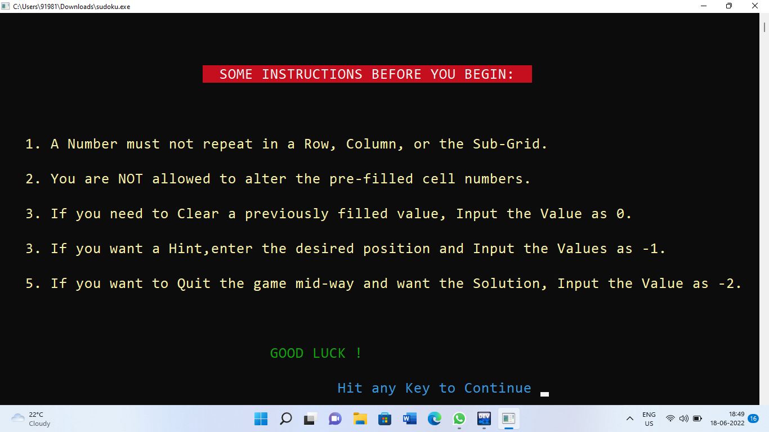
INSTRUCTIONS to Play Sudoku gets displayed as follows :

Slide 34
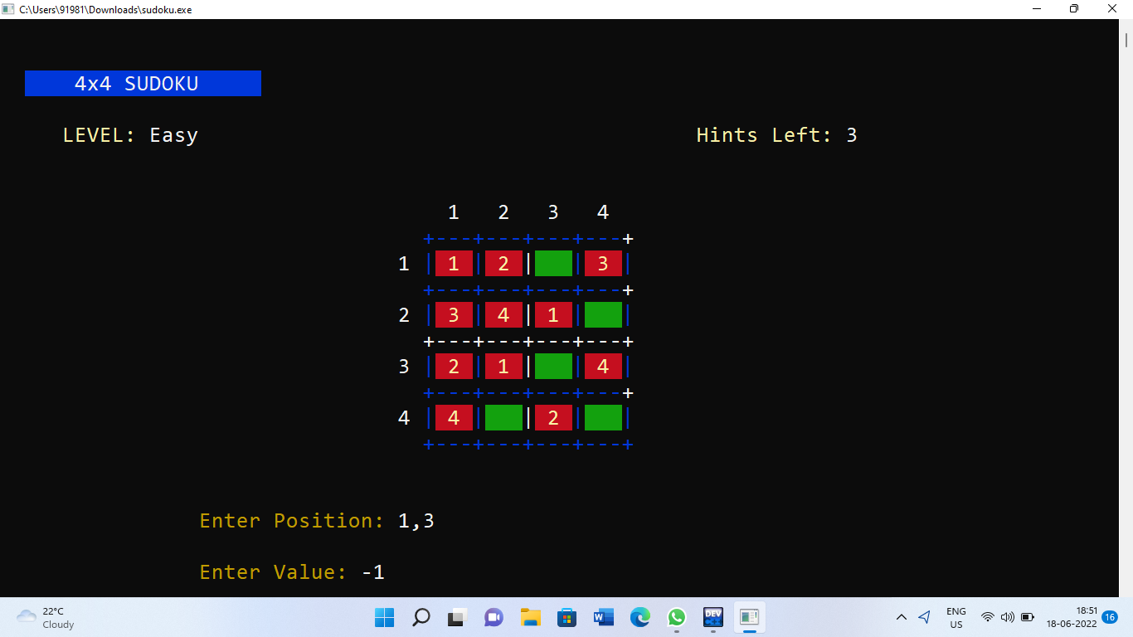
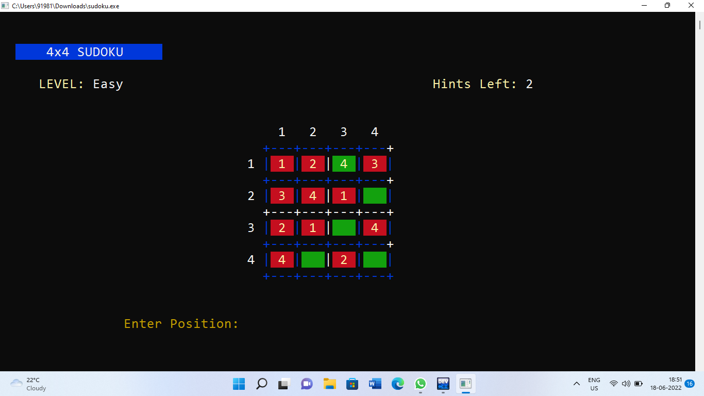
In order to play Sudoku, enter Position as x,y coordinates and enter value to input. Entering -1 as per the instructions is choosing to take Hint so the position gets itself filled and leftover Hints get reduced.

Slide 35
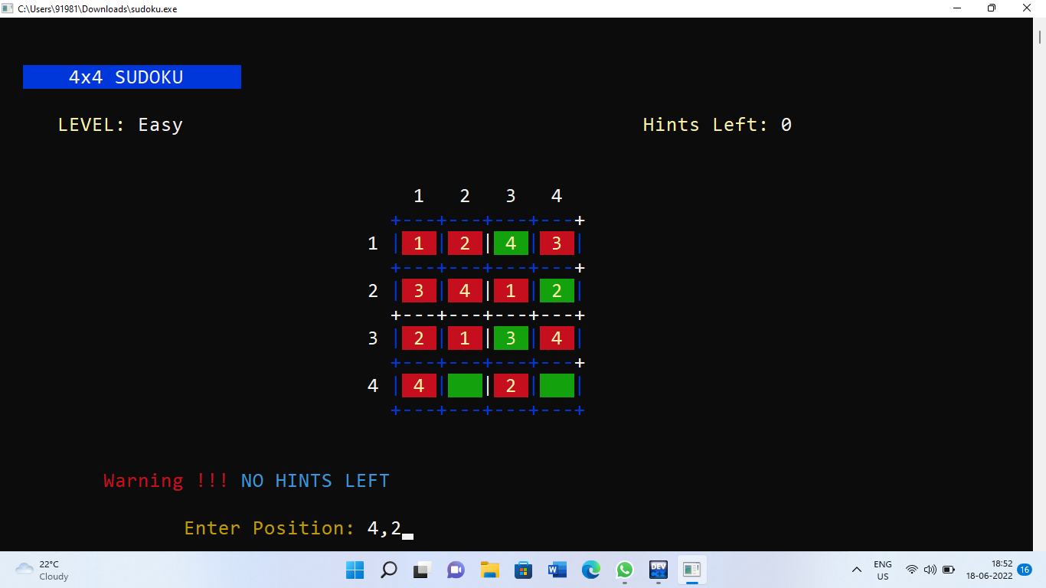
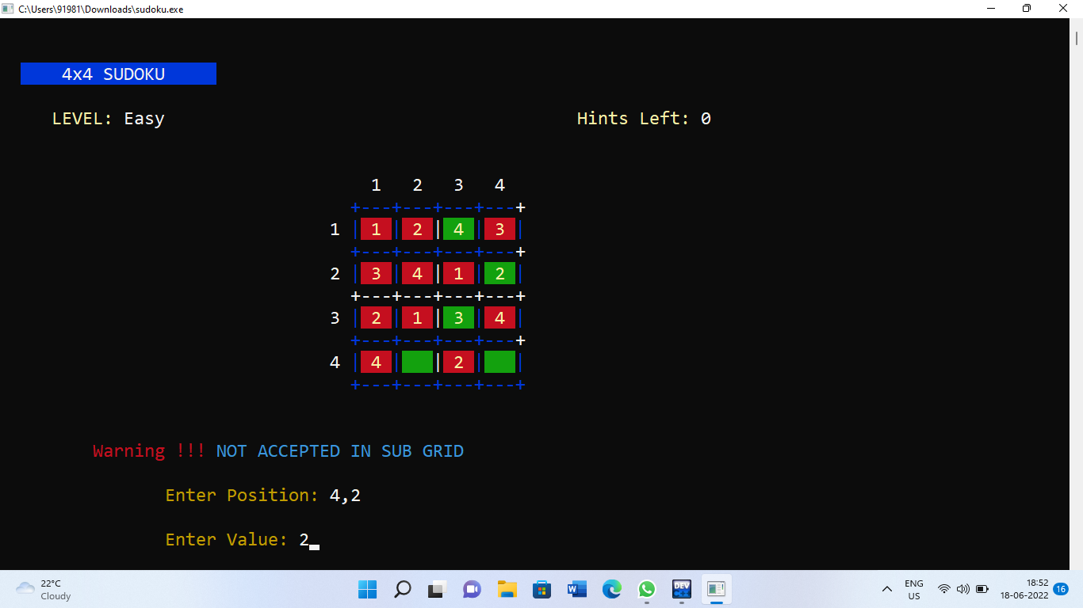
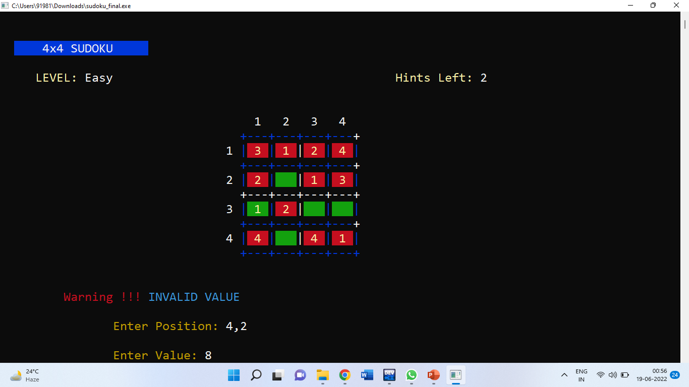
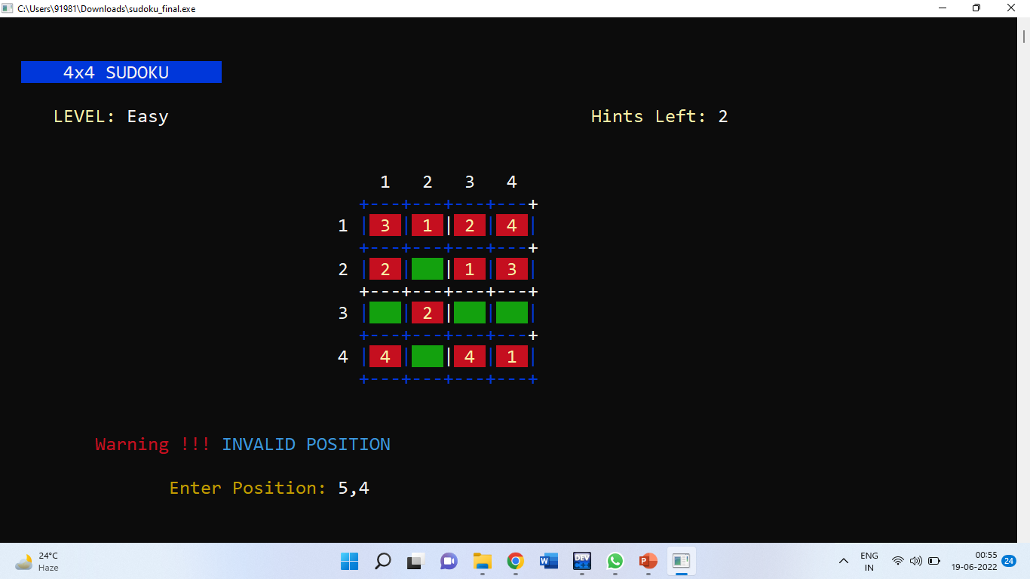
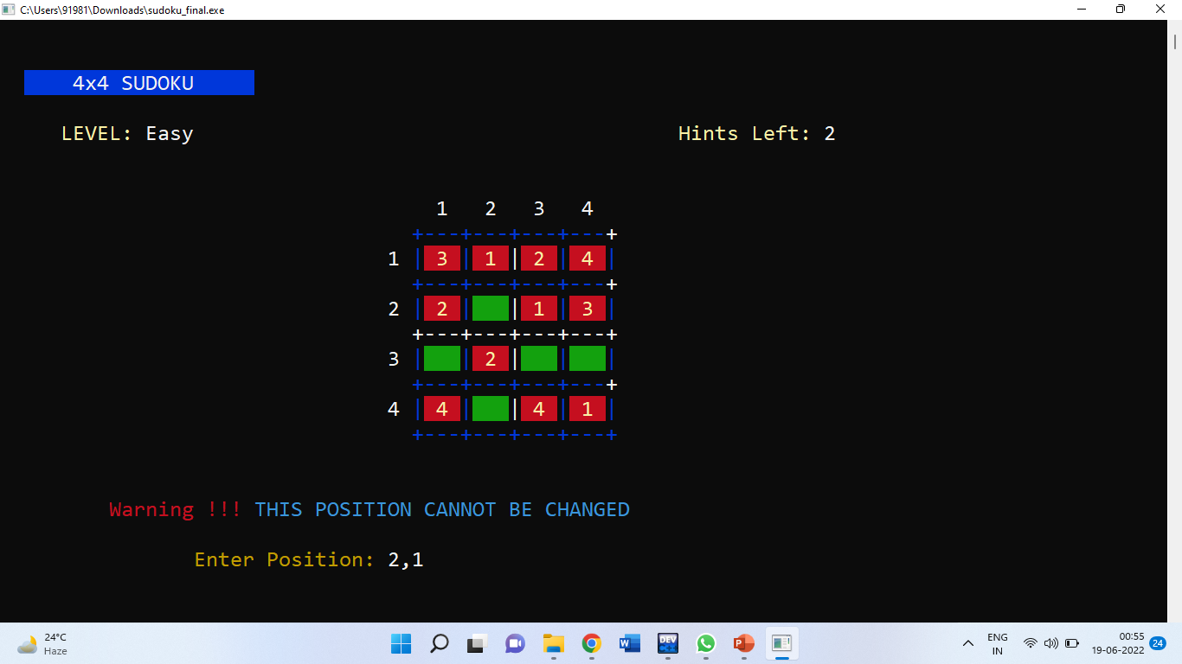
On using all Hints an error message gets displayed : NO HINTS LEFT
On entering wrong answers in the sub grid by not following instructions, an error message gets displayed.
Error Messages based on Invalid Value, Invalid Position, changing fixed value

Slide 36
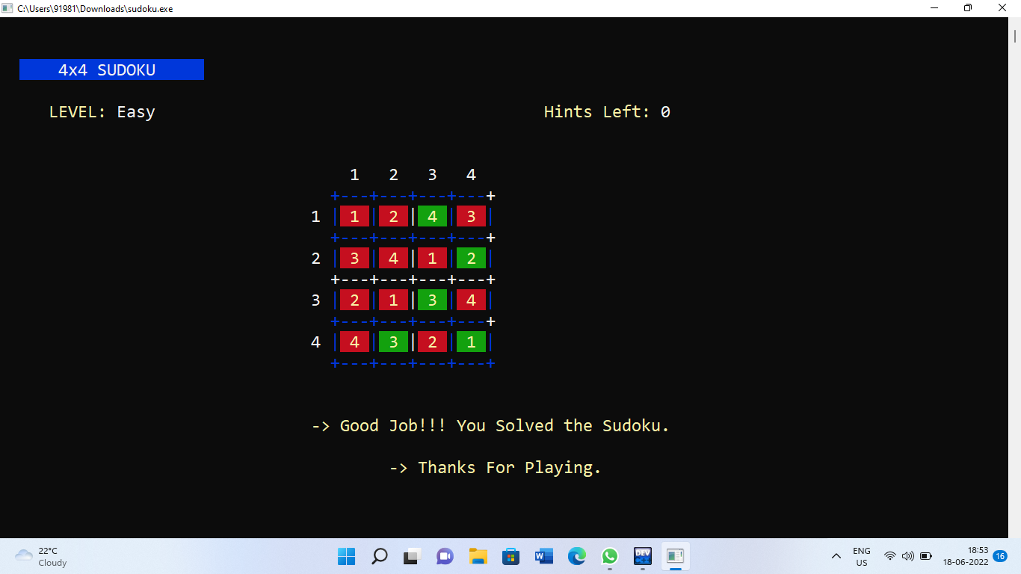
You can either use hints or choose to play till the end. This is how Sudoku ends

Slide 37
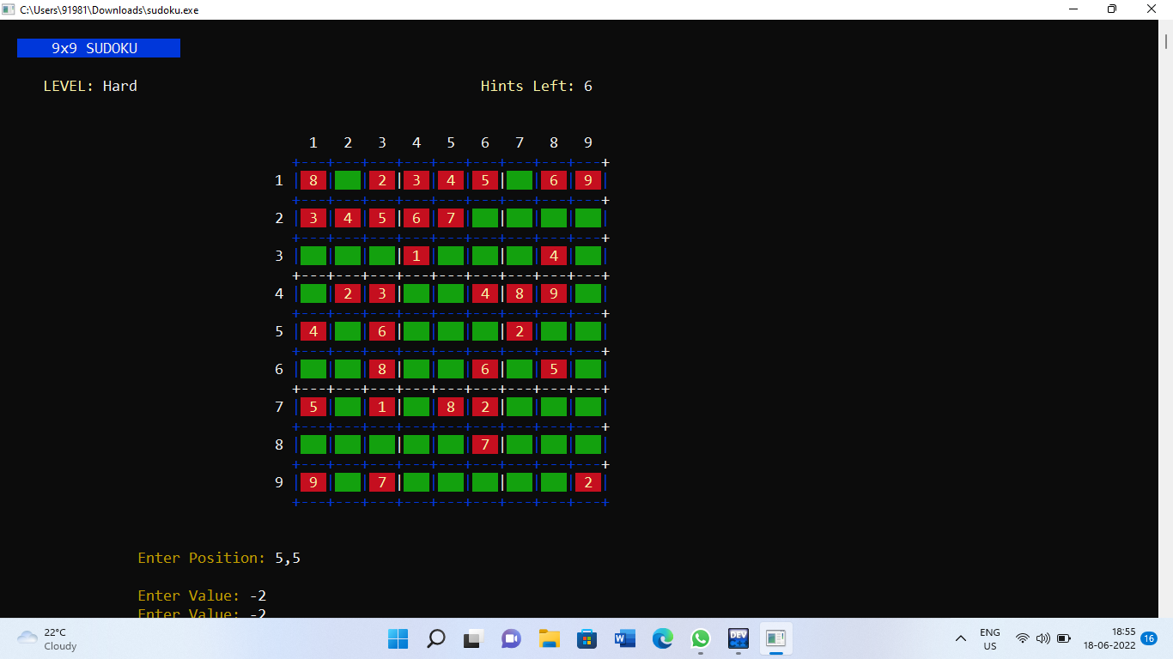
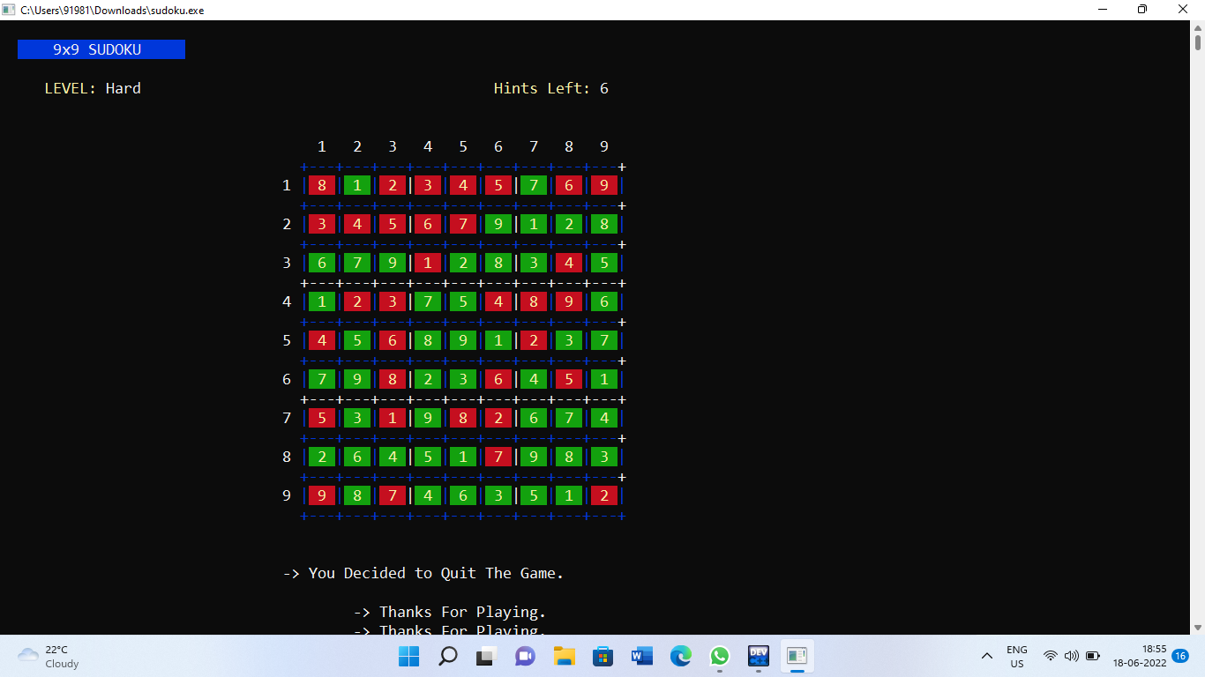
This is how a 9*9 grid looks . In order to Quit, you can press -2 and it will end the game with the final answer grid displayed.

Slide 38

BIBLIOGRAPHY
https://www.youtube.com
https://www.google.co.in

Slide 39


